Slide 1
Applied Data Science Course
Capstone Project Presentation

Slide 2
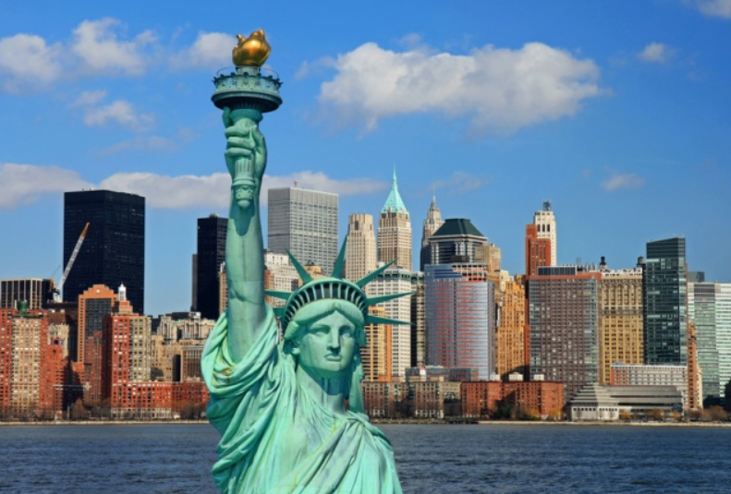
Friendly Neighborhood Project – Data Collect.
New York City
Choice for
Data analysis given easy availability of information

Slide 3
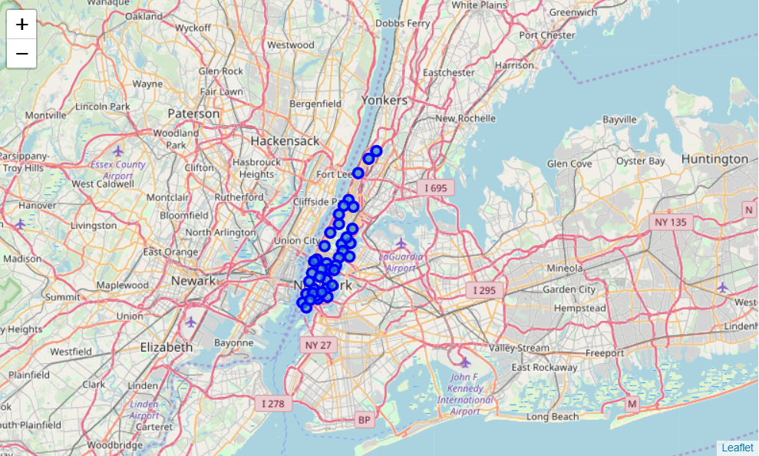
Friendly Neighborhood Project – Data Visuals
Venues identified for the NYC
Categorized based on restaurants, tourist places, hospitals, schools.

Slide 4
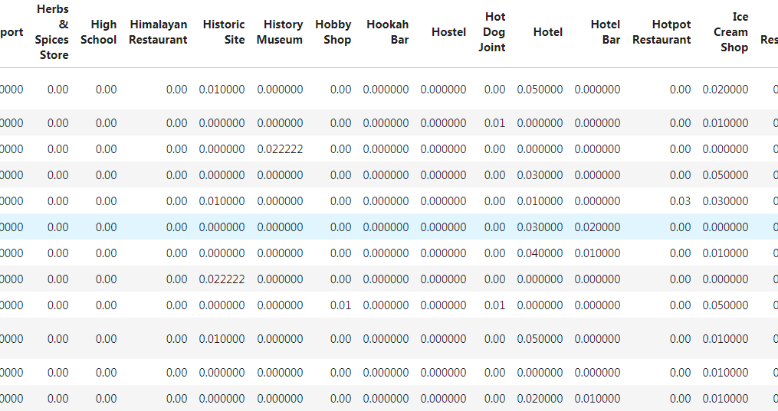
Friendly Neighborhood Project –Data Analysis
Top venues were identified if they are schools or museums or hostels and so on.

Slide 5
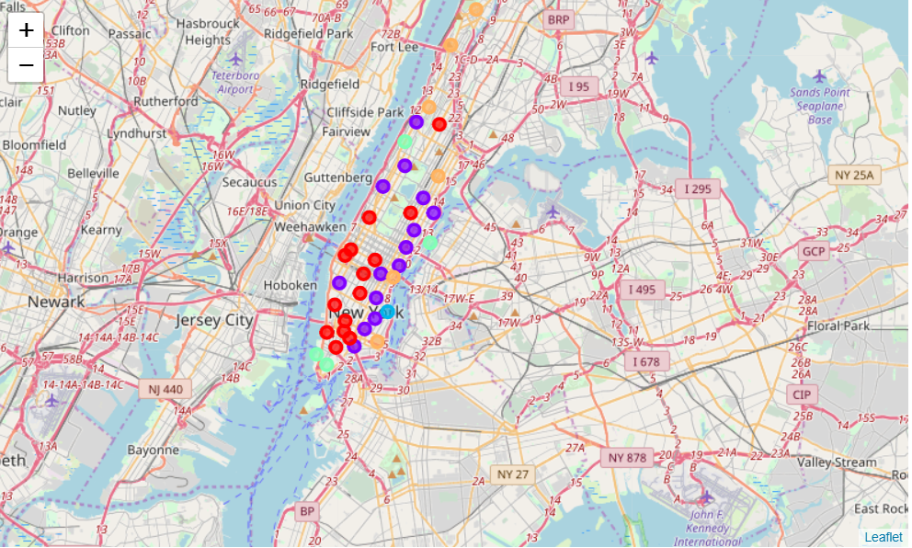
Friendly Neighborhood Project - Method
Venues were clustered and color coded to identify popular neighborhoods.

Slide 6
Friendly Neighborhood Project – Conclusion.
Popular areas are safe areas with relatively safer school districts.
Serves as indicator for new settlers in the City.

Slide 7
Thank you.
Capstone Project Presentation

